Slide 1
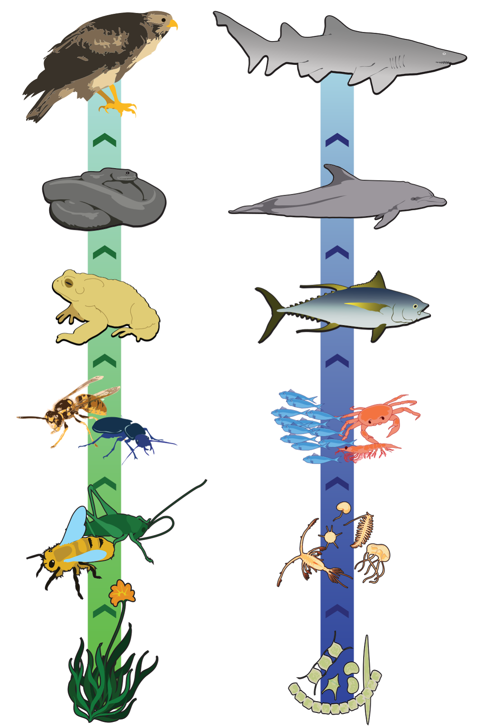
Stable Isotopes as Ecological Tools
Tessa Holzmann (tholzman@ucsc.edu)
Notes:
Whats an isotope?

Slide 2
Stable isotope ecology primarily compares the fractionation of individual elements between members of an ecosystem to understand their behavior and physiology.

Slide 3
Stable isotope ecology primarily compares the fractionation of individual elements between members of an ecosystem to understand their behavior and physiology
Why? How?

Slide 4

Justification
Everything you eat and your environment has a distinct chemical/mineral/microbial makeup.
You are what you eat– these things are incorporated into your body and leave “fingerprints” on your soft and hard tissues.

Slide 5
You may know about tracking the decay of radioisotopes from as a strategy for age dating
However, not all isotopes decay– some are stable through time.
Stable isotopes inside an organism’s body reflect its life habits
…..WAIT!! How do we distinguish between these isotopes to discover those life habits?

Slide 6
Stable isotope ecology primarily compares the fractionation of individual elements between members of an ecosystem to understand their behavior and physiology
What does that mean?

Slide 7
Isotope Fractionation
“Light” isotopes are generally more abundant, but….
Reality:
Mass difference between “light” and “heavy” isotopes is in the .000s.
Mass specs are bad at counting.
Isotope properties are usually fairly similar.
These things won’t help us. What can?

Slide 8
Isotope Fractionation
There IS a difference in bond and kinetic energy between heavy and light isotopes
Therefore, (usually) light isotopes will react FIRST
Great!!! so if a reaction does not have 100% yield, you can see FRACTIONATION in stable isotopes of a system
We can use a mass spectrometer to measure the ratios between heavy/light isotopes to quantify this fractionation
Notes:
Eating things example

Slide 9
Stable isotope ecology primarily compares the fractionation of individual elements between members of an ecosystem to understand their behavior and physiology
Why are they different?
Notes:
Last step: we need to understand where fractionation reliably occurs for different elements, then we can make begin to understand the data in front of us.

Slide 10
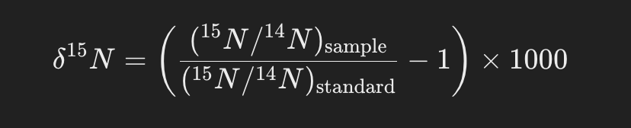
Example: δ¹⁵N
Nitrogen (N) is found in your proteins and nucleic acids
The most abundant isotopes of Nitrogen are ¹⁵N and ¹⁴N
Plants reflect the N composition of the atmosphere (light)
Consumers preferentially take up heavy N from their food (plants/animals)
Notes:
Consumers pref take up heavy N because they’re better for building proteins

Slide 11
Stable isotope ecology primarily compares the fractionation of individual elements between members of an ecosystem to understand their behavior and physiology
Ahhh… I get it!!!
Notes:
Last step: we need to understand where fractionation reliably occurs for different elements, then we can make begin to understand the data in front of us.

Slide 12
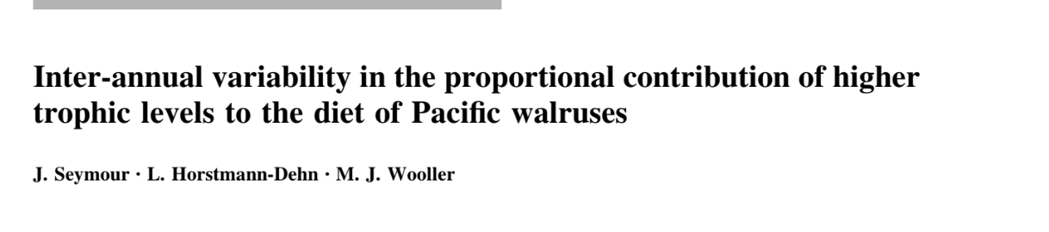
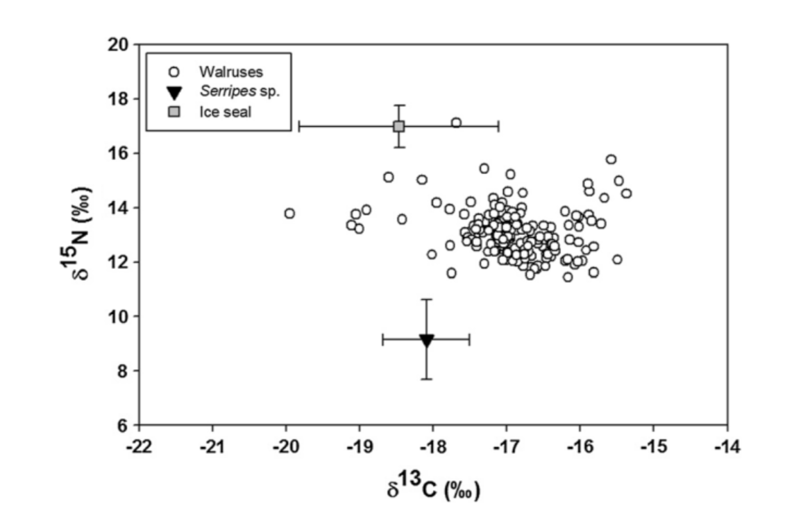

Cold, unproductive water Warm, productive water
Notes:
What do walruses eat? What do ice seals eat?
Why are some walruses tracking trophically with ice seals if they primarily eat Serripes?

Slide 13
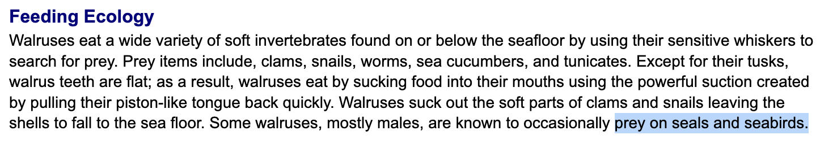
afwd.alaska.gov
Notes:
Some walruses eat seals– we have evidence of this isotopically.

